Slide 1
Chapter 18 (Part 1): Semiconductors

Slide 2
Objectives
After completing Part 1 of this chapter, you will be able to:
Know the structure of common semiconductor materials.
Explain the concept of electron-hole pairs.
Differentiate between intrinsic and extrinsic semiconductors.
Describe the effects of doping.
Identify the majority and minority charge carriers in p-type and n-type semiconductors.
Describe the potential barrier in a PN Junction.
Explain how the depletion region is affected when the pn junction is forward-biased and reversed-biased.

Slide 3
18-1 Conductors, Insulators & Semiconductors
Materials can be classified according to their electrical properties:
Conductors
Insulators
Semiconductors

Slide 4
Conductors
Materials that conduct electrical current easily
Examples are copper, silver, gold
Atoms can have 1, 2 or 3 very loosely bound valence electrons
Valence electrons are electrons at the outermost orbit of the atom. Such electrons can easily break away and become free electrons
Hence a conductor has many free electrons available to support current flow when a voltage is applied.

Slide 5
Insulators
Materials that do not conduct electrical current under normal conditions
Usually compounds rather than elements
Atoms have 5 or more very tightly bound valence electrons which cannot break away easily from the atoms
Hence very few free electrons present to support current flow when voltage is applied

Slide 6
Semiconductors
Materials which electrical conductivity is between that of conductors and insulators
Intrinsic (pure) semiconductor is neither a good conductor nor good insulator
Characterised by atoms having 4 valence electrons which are moderately bound to the atoms
Examples are:
- Carbon
- Silicon
- Germanium

Slide 7
Structure of Semiconductor Atoms
N
N
N
Carbon (6)
Silicon (14)
Note that there are exactly 4 valence electrons in all these atoms
Germanium (32)
Hence they are semiconductors

Slide 8
Semiconductor Atoms vs
Conductor Atoms
N
N
Silicon(14)
Copper (29)
4 Valence electrons
SEMICONDUCTOR!!
1 Valence electron
CONDUCTOR!!

Slide 9
18-2 Energy Bands
When a valence electron acquires enough additional energy, it is able to leave its valence shell and become a free electron
Such electrons are said to move from the valence energy band to the conduction energy band
The difference in energy between the 2 energy bands is called an energy gap.

Slide 10
Energy Bands
An insulator has a large energy gap that is very difficult to breach even with a lot of additional energy
A semiconductor has a small energy gap that may be breached with some amount of external energy
A conductor’s valence band overlaps with the conduction band. There is no energy gap
Hence a conductor has free electrons even without external excitation

Slide 11
Energy Bands
Energy
Energy
Energy
Conduction band
Overlap
Conduction band
Energy gap
Energy gap
Conduction band
Valence band
Valence band
Valence band
0
0
0
Insulator
Semiconductor
Conductor
The conduction band and valence band in conductor overlaps resulting in large number of free electrons even without external energy

Slide 12
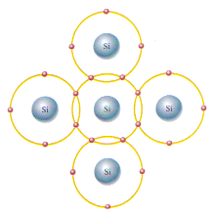
18-3 Covalent Bonds
Pure (intrinsic) Silicon has no impurities and is a crystalline material
Its atoms are held together by covalent bonds (sharing of electrons)
Centre atom shares 1 electron with each of four surrounding atoms creating a covalent bond with each.
The surrounding atoms are in turn bonded to other atoms, and so on.

Slide 13
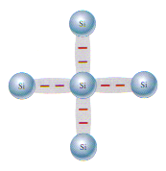
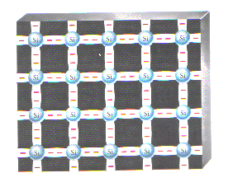
Covalent Bonds
Another way of representing covalent bonds
Bonding Diagram.
The red negative signs
represent the shared
valence electrons.
Covalent bonds
form a crystal
structure.

Slide 14
18-4 Conduction in Semiconductors
If an electron is unexcited, it stays within its prescribed atomic shell
Each shell is separated from adjacent shells by energy gaps
Atomic shells can thus be looked upon as energy bands where electrons with similar energy levels reside

Slide 15
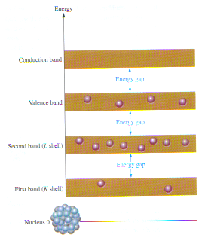
Energy
No electrons in this band
Energy band diagram for an unexcited silicon atom.
There are no electrons in the conduction band.
Conduction band
Energy gap
Valence band
Energy gap
Second band
(L shell)
Energy gap
Electrons stay within energy bands
First band
(K shell)
Nucleus 0
A Silicon Atom

Slide 16
Electron-Hole Pair
When electrons receive heat or light energy from their surroundings, some valence electrons may gain sufficient energy to jump to another energy band
Some jump from valence band into the conduction band
These then become free electrons and are free to drift
These electrons become conduction electrons

Slide 17
Electron-Hole Pair
Electrons that break free from the atom leave behind a vacancy in the valence band called a hole
This hole forms together with the free electron an electron-hole pair
The number of electron-hole pairs in an intrinsic semiconductor is not plentiful

Slide 18
Electron-Hole Pair
Some excited electrons may lose their energy after a while and fall back into a hole in the valence band. This process is called recombination
There is a dynamic process where electrons are constantly breaking free and falling back to the valence band

Slide 19
Electron-Hole Pair
In summary,
Intrinsic silicon at room temperature has a very small amount of free electrons that are unattached and drifting randomly throughout the material
There are also an equal number of holes in the valence band created when these electrons jump into the conduction band
Just as electrons gain energy to break free from an atom, they will recombine with existing holes once they lose that energy

Slide 20
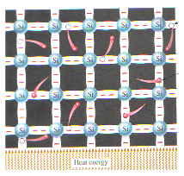
Electron-Hole Pair
Generation of an electron-hole pair
Recombining of an
electron with a hole
Heat energy

Slide 21
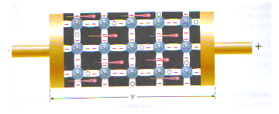
Electron and Hole Current
Electron Current
When a voltage is applied across a piece of intrinsic silicon, its free electrons are attracted to the positive end
This movement of free electrons is called electron current
Electron current in intrinsic silicon is produced by the movement of thermally generated free electrons.

Slide 22
Electron and Hole Current
Hole current
As free electrons move towards the positive end of the battery, some of them will be attracted to the holes left behind
As these electrons occupy the holes, these holes effectively “move” from one place to another within the crystal structure
This “movement” of holes is called hole current

Slide 23
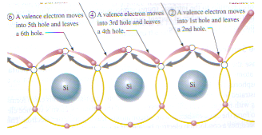
Electron and Hole Current
4. Valence electron moves into 3rd hole and leaves a 4th hole.
2. Valence electron moves into 1st hole and leaves a 2nd hole.
3. Valence electron moves into 2nd hole and leaves a 3rd hole.
1. Free electron leaves hole in valence shell
6. Valence electron moves into 5th hole and leaves a 6th hole.
5. Valence electron moves into 4th hole and leaves a 5th hole.
When a valence electron moves from left to right to fill a hole while leaving another hole behind, a hole has effectively moved from right to left.
Grey arrow indicates effective movement of a hole.

Slide 24
Electron and Hole Current
Note, however, that in intrinsic semiconductor, the electron and hole currents are negligible because of the limited number of electron-hole pairs

Slide 25
18-5 N-type and P-type Semiconductors
Intrinsic semiconductors are actually quite poor conductors because of limited number of free electrons in the conduction band and holes in valence band
They must be modified so that they possess more free electrons and holes. In this way, they become more conductive and useful
This is done by adding impurities to it
This process is called doping

Slide 26
N-type and P-type Semiconductors
Doping is the process of adding impurities to intrinsic semiconductor to improve its conductivity
This results in an increase in the number of current carriers (electrons or holes)
An intrinsic semiconductor doped with impurities becomes an extrinsic (impure) semiconductor

Slide 27
N-type and P-type Semiconductors
There are two types of extrinsic semiconductors
N-type semiconductor is formed by adding pentavalent impurities e.g. arsenic (As), phosphorus (P), bismuth (Bi), antimony (Sb) to Silicon
Pentavalent atoms have 5 valence electrons
P-type semiconductor is formed by adding trivalent impurities e.g. aluminium (Al), boron (B), indium (In), gallium (Ga) to Silicon
Trivalent atoms have 3 valence electrons

Slide 28
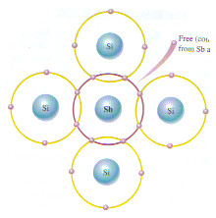
N-type Semiconductor
In N-type semiconductors, each pentavalent atom (e.g. antimony) forms covalent bonds with four adjacent silicon atoms.
1 extra antimony electron is left behind as a free electron
Free (conduction) electron from Antimony atom
This extra free electron improves the conductivity of the semiconductor
Antimony is said to be a donor atom

Slide 29
Majority and Minority Carriers in N-type Semiconductor
Semiconductors doped with pentavalent atoms are called n-type material because most of its current carriers are electrons (n = negative charge)
Its majority carriers are electrons
A few holes are also present but these are thermally generated electron-hole pairs and NOT produced by the addition of pentavalent impurities
Holes are minority carriers in an n-type material

Slide 30
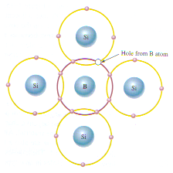
P-type Semiconductor
Another alternative is to increase the number of holes in intrinsic silicon
To do this, trivalent impurity atoms (e.g. Boron) are added
These atoms have 3 valence electrons but form covalent bonds with 4 silicon atoms leaving behind a hole each time
Hole formed by Boron atom
Boron is said to be an acceptor atom

Slide 31
Majority and Minority Carriers in P-type Semiconductor
Semiconductors doped with trivalent atoms are called p-type material because most of its current carriers are holes (p = positive charge)
Holes can be thought of as positive charges because the shortage of an electron gives an atom a net positive charge
The majority carriers here are holes
A few electrons are also present but these are thermally generated electron-hole pairs and NOT produced by the addition of trivalent impurities
Electrons are minority carriers in a p-type material

Slide 32
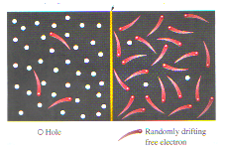
18-6 The p-n Junction
When intrinsic silicon is doped so that one part is n-type and the other part is p-type, a p-n junction is formed at the boundary
The p-n junction is the principle used in devices such as diodes and transistors
pn junction
p region
n region
hole
Randomly drifting free electron

Slide 33
The p-n Junction
Before p-n junction is formed, n-type and p-type materials have equal number of electrons and protons. Both materials are charge neutral
After the p-n junction is formed, free electrons in the n-region will diffuse into the p-region near the junction to combine with holes there
Every time this happens, a positive charge is left behind in the n-region and a negative charge is created in the p region

Slide 34
Formation of Depletion Region
The n region loses electrons creating a layer of positive charges
The p region loses holes creating a layer of negative charges
The junction itself gets depleted of charge carriers and forms a depletion region.
This action continues until the voltage in the depletion region repels further diffusion.
The depletion region acts as a barrier to hinder electron diffusion across the junction
34

Slide 35
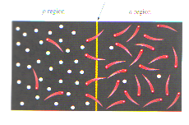
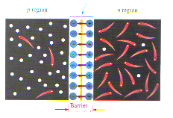
Formation of Depletion Region
Depletion region
pn junction
p region
n region
p region
n region
+
+
+
+
+
+
+
+
Before Diffusion
Barrier potential
After Diffusion

Slide 36
Barrier Potential
In the depletion region, there are many positive and negative charges on opposite sides of the p-n junction
These electric charges form an electric field
The potential difference of the electric field across the depletion region is the amount of energy required to move electrons through the electric field
This difference is called the barrier potential
For Silicon, it is 0.7V at 25ºC
For Germanium, it is 0.3V at 25ºC

Slide 37
18-7 Biasing a p-n Junction
Bias refers to the application of a dc voltage to control current flow in an electronic device
There are two bias conditions:
Forward bias
Reverse bias
Either of these bias conditions can be established by connecting a sufficient dc voltage of the proper polarity across the p-n junction

Slide 38
Biasing a p-n Junction
Forward bias voltage connection:
positive to p region
negative to n region
Bias voltage must be greater than barrier potential (0.7V Si; 0.3V Ge)
Majority carriers provide forward current and flow toward the p-n junction
Forward Biasing
p region
n region
p
n
R
+ V_{BIAS}
Forward Bias:
PERMITS Current
The depletion region narrows

Slide 39
Biasing a p-n Junction
Reverse Biasing
Reverse bias voltage connection
positive to n region
negative to p region
The depletion region widens
Minority carriers provide a small reverse current
p region
n region
p
n
R
V_{BIAS} +
Reverse Bias:
PREVENTS Current
Bias voltage must be less than breakdown voltage.
39

Slide 40
Summary
Semiconductor materials like silicon and germanium have four valence electrons in their atomic structure
The conductivity of semiconductors is improved by adding impurities
An n-type semiconductor material is obtained by adding pentavalent (donor) impurities
A p-type semiconductor is obtained by adding trivalent (acceptor) impurities
The majority carriers in an n-type semiconductor are free electrons acquired by the doping process, and the minority carriers are holes produced by thermally generated electron-hole pairs

Slide 41
Summary
The majority carriers in a p-type semiconductor are holes acquired by the doping process, and the minority carriers are free electrons produced by thermally generated electron-hole pairs
A pn junction diode is made from p-type and n-type semiconductors
The barrier potential in the depletion region is 0.7V and 0.3V for silicon and germanium respectively
The pn junction can be forward-biased or reversed-biased. When forward-biased, there is a forward current. When reversed-biased, there is no current flow, except for a small reverse current

Slide 42
End of Chapter 18 (Part 1)

